Slide 1
ROSHN GROUP — NATIONAL DAY FILM STORYBOARD
WE BUILD IT TOGETHER
Detailed Production and Post-Production Storyboard
60 seconds | 70% archive footage | 30% employee filming
Main 16:9 version • 9:16 safe area maintained for social cutdowns
Visual motif: a green line begins on the masterplan and links every scene.

Slide 2
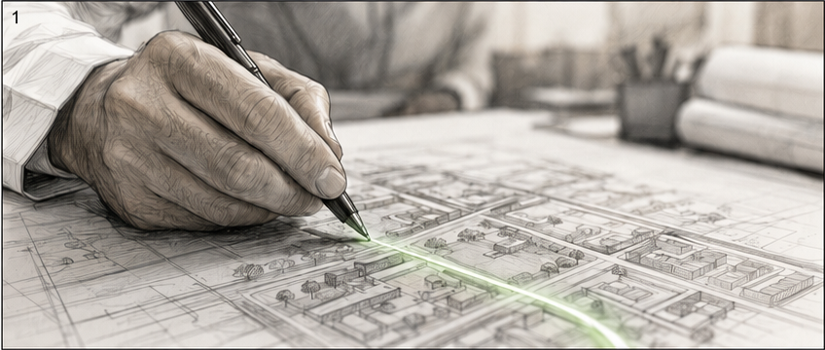
WE BUILD IT TOGETHER
FRAME 01
00:00 – 00:04
IMAGE & MOVEMENT
Macro shot of a hand drawing a line across a project masterplan. The line gradually becomes a glowing green trace.
ON-CAMERA DIALOGUE
—
VOICE-OVER
«كل بناء… يبدأ بخط.»
TRANSITION
The camera follows the line across the masterplan as it continues into the next frame.
ROSHN NATIONAL DAY FILM • STORYBOARD
2 / 16
FRAME DURATION: 4 SECONDS

Slide 3
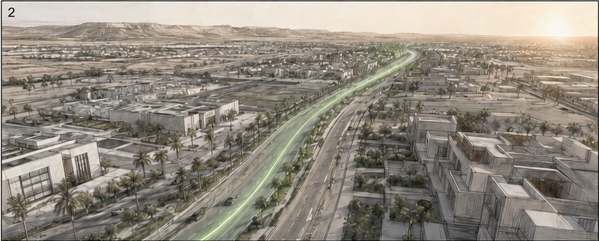
WE BUILD IT TOGETHER
FRAME 02
00:04 – 00:08
IMAGE & MOVEMENT
The masterplan transforms into a wide drone shot of a modern road and community. The green line extends toward the horizon.
ON-CAMERA DIALOGUE
—
VOICE-OVER
«لكن بناء الوطن… يبدأ برؤية.»
TRANSITION
Match cut from the line on the masterplan to the road, maintaining the forward camera movement.
ROSHN NATIONAL DAY FILM • STORYBOARD
3 / 16
FRAME DURATION: 4 SECONDS

Slide 4
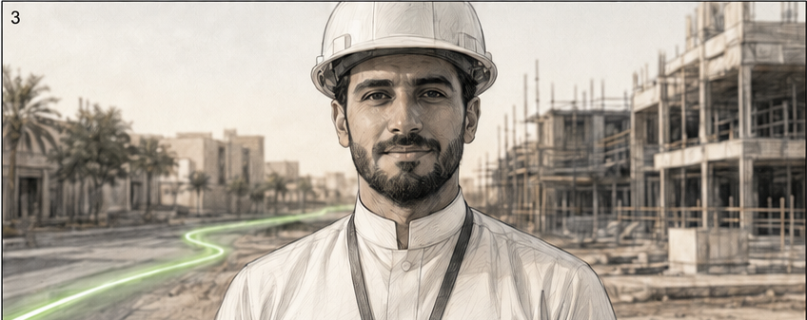
WE BUILD IT TOGETHER
FRAME 03
00:08 – 00:11
IMAGE & MOVEMENT
A ROSHN employee at the project site, framed in a medium shot and looking directly into camera, with a subtle push-in.
ON-CAMERA DIALOGUE
الموظف: «وطن.»
VOICE-OVER
—
TRANSITION
The green line passes behind the employee and leads into the architectural details of the next scene.
ROSHN NATIONAL DAY FILM • STORYBOARD
4 / 16
FRAME DURATION: 3 SECONDS

Slide 5
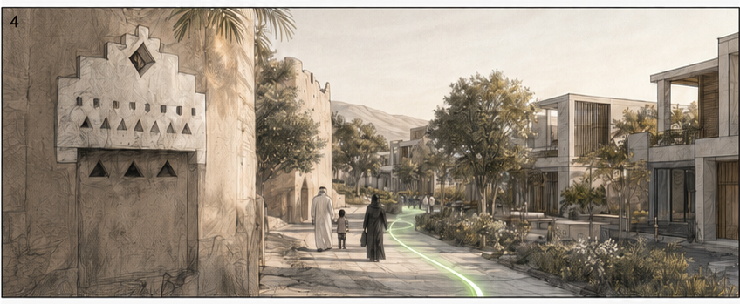
WE BUILD IT TOGETHER
FRAME 04
00:11 – 00:16
IMAGE & MOVEMENT
A visual transition from traditional Saudi architectural details to a vibrant modern community.
ON-CAMERA DIALOGUE
—
VOICE-OVER
«وطنٌ نعتز بجذوره… ونمضي برؤيته.»
TRANSITION
Match cut between traditional patterns and masses and the forms of the modern façades.
ROSHN NATIONAL DAY FILM • STORYBOARD
5 / 16
FRAME DURATION: 5 SECONDS

Slide 6
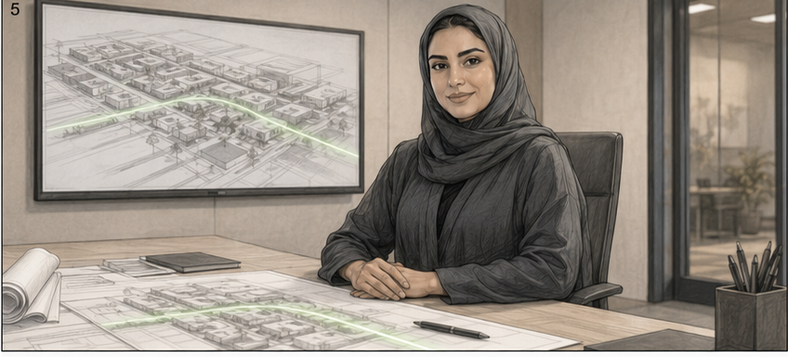
WE BUILD IT TOGETHER
FRAME 05
00:16 – 00:19
IMAGE & MOVEMENT
A female employee seated at her desk inside an enclosed office, with plans in front of her and the project screen on the wall.
ON-CAMERA DIALOGUE
الموظفة: «طموح.»
VOICE-OVER
—
TRANSITION
The green line travels from the plan on the desk to the project screen, then into the construction site.
ROSHN NATIONAL DAY FILM • STORYBOARD
6 / 16
FRAME DURATION: 3 SECONDS

Slide 7
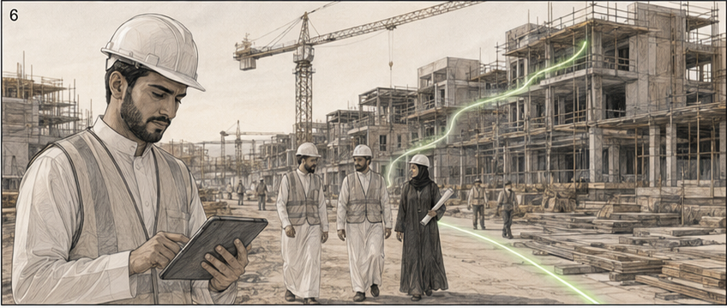
WE BUILD IT TOGETHER
FRAME 06
00:19 – 00:25
IMAGE & MOVEMENT
Engineering teams at work: digital plans, cranes, and advanced stages of construction across the project site.
ON-CAMERA DIALOGUE
—
VOICE-OVER
«طموحٌ نحوّله كل يوم إلى واقع.»
TRANSITION
An upward move follows the line along the buildings, then cuts to the entrance frame in the next shot.
ROSHN NATIONAL DAY FILM • STORYBOARD
7 / 16
FRAME DURATION: 6 SECONDS

Slide 8
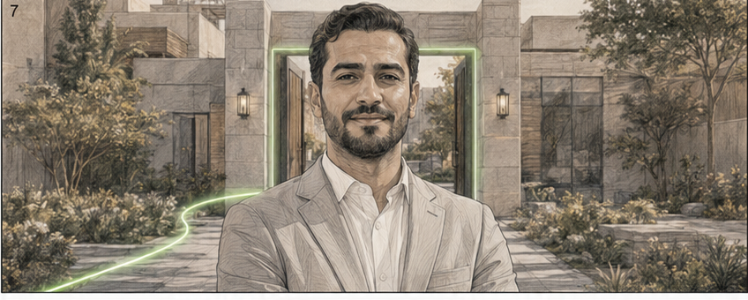
WE BUILD IT TOGETHER
FRAME 07
00:25 – 00:28
IMAGE & MOVEMENT
An employee at the entrance of a completed community, framed in a medium shot and looking directly into camera.
ON-CAMERA DIALOGUE
الموظف: «انتماء.»
VOICE-OVER
—
TRANSITION
The green line outlines the entrance and becomes a glowing threshold inside the home.
ROSHN NATIONAL DAY FILM • STORYBOARD
8 / 16
FRAME DURATION: 3 SECONDS

Slide 9
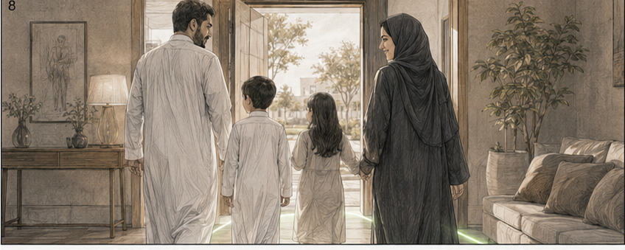
WE BUILD IT TOGETHER
FRAME 08
00:28 – 00:34
IMAGE & MOVEMENT
A Saudi family enters their home in a warm, natural moment, with daylight flowing through the doorway.
ON-CAMERA DIALOGUE
—
VOICE-OVER
«انتماءٌ يجعل من المكان بيتًا… ومن التفاصيل حياة.»
TRANSITION
The doorway light fills the frame and becomes natural light in the landscaped park.
ROSHN NATIONAL DAY FILM • STORYBOARD
9 / 16
FRAME DURATION: 6 SECONDS

Slide 10
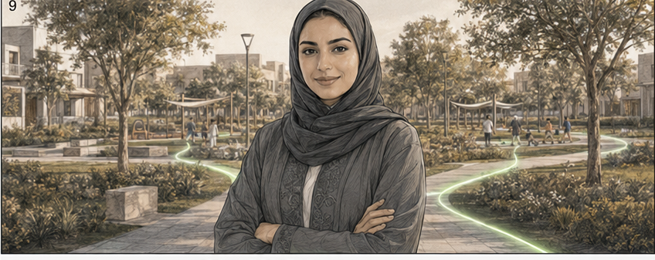
WE BUILD IT TOGETHER
FRAME 09
00:34 – 00:37
IMAGE & MOVEMENT
A female employee stands in a landscaped public space, centered for both horizontal and vertical formats.
ON-CAMERA DIALOGUE
الموظفة: «مجتمع.»
VOICE-OVER
—
TRANSITION
The green line branches behind her into several walking and movement paths.
ROSHN NATIONAL DAY FILM • STORYBOARD
10 / 16
FRAME DURATION: 3 SECONDS

Slide 11
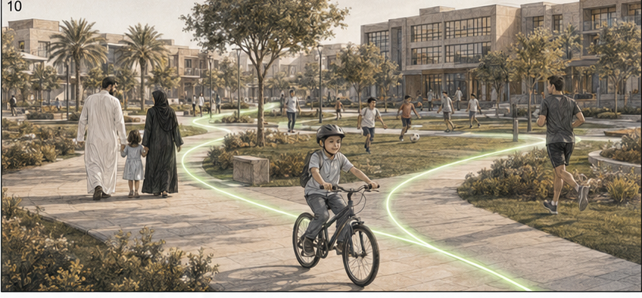
WE BUILD IT TOGETHER
FRAME 10
00:37 – 00:43
IMAGE & MOVEMENT
Everyday community life: families, children, cycling, sports, and connected green spaces.
ON-CAMERA DIALOGUE
—
VOICE-OVER
«مجتمعٌ يجمعنا… وينمو معنا.»
TRANSITION
The camera follows one of the green paths toward the horizon.
ROSHN NATIONAL DAY FILM • STORYBOARD
11 / 16
FRAME DURATION: 6 SECONDS

Slide 12
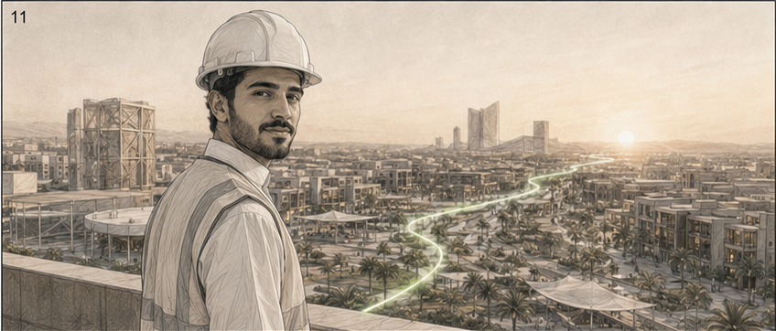
WE BUILD IT TOGETHER
FRAME 11
00:43 – 00:46
IMAGE & MOVEMENT
A young engineer looks over the community from an elevated viewpoint, then turns slightly toward camera.
ON-CAMERA DIALOGUE
الموظف: «مستقبل.»
VOICE-OVER
—
TRANSITION
The line extends from behind him toward the horizon as the frame widens to reveal future destinations.
ROSHN NATIONAL DAY FILM • STORYBOARD
12 / 16
FRAME DURATION: 3 SECONDS

Slide 13
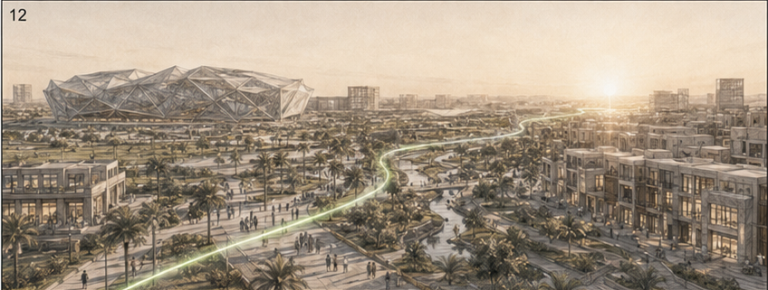
WE BUILD IT TOGETHER
FRAME 12
00:46 – 00:52
IMAGE & MOVEMENT
A wide montage of key ROSHN projects and destinations: communities, public spaces, urban infrastructure, and a future stadium.
ON-CAMERA DIALOGUE
—
VOICE-OVER
«مستقبلٌ نبنيه اليوم… لأجيال الغد.»
TRANSITION
A subtle rhythmic acceleration leads into a multi-frame employee layout.
ROSHN NATIONAL DAY FILM • STORYBOARD
13 / 16
FRAME DURATION: 6 SECONDS

Slide 14
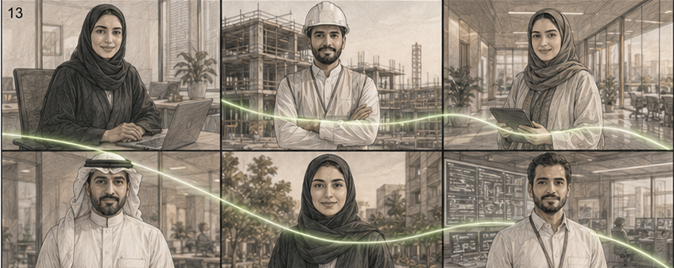
WE BUILD IT TOGETHER
FRAME 13
00:52 – 00:56
IMAGE & MOVEMENT
A split screen presents employees from different departments and locations, visually connected by the green line.
ON-CAMERA DIALOGUE
بالتتابع: «برؤيتنا… بعزيمتنا… وبأيدينا…»
VOICE-OVER
«من كل موقع… ومن كل تخصص… نضع أثرنا في قصةٍ واحدة.»
TRANSITION
The split-screen panels gradually merge into one collective group shot.
ROSHN NATIONAL DAY FILM • STORYBOARD
14 / 16
FRAME DURATION: 4 SECONDS

Slide 15
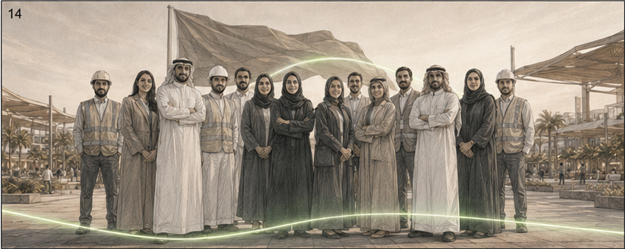
WE BUILD IT TOGETHER
FRAME 14
00:56 – 00:58
IMAGE & MOVEMENT
A group portrait of ROSHN employees in front of a destination, looking naturally and proudly toward camera.
ON-CAMERA DIALOGUE
الجميع: «هذه المملكة… نبنيها معًا.»
VOICE-OVER
—
TRANSITION
The green line rises behind the group and fills the frame with green.
ROSHN NATIONAL DAY FILM • STORYBOARD
15 / 16
FRAME DURATION: 2 SECONDS

Slide 16

WE BUILD IT TOGETHER
FRAME 15
00:58 – 01:00
IMAGE & MOVEMENT
Final end card featuring the approved National Day identity, the supplied ROSHN Group logo lockup, and the campaign line.
ON-CAMERA DIALOGUE
الجميع / VO: «دام عزك يا وطن.»
VOICE-OVER
النص على الشاشة: «نبنيها معًا»
TRANSITION
Hold the logo lockup and campaign line, then finish on a clean musical resolve and fade out.
ROSHN NATIONAL DAY FILM • STORYBOARD
16 / 16
FRAME DURATION: 2 SECONDS

